Slide 1
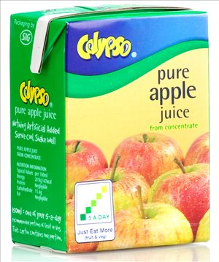
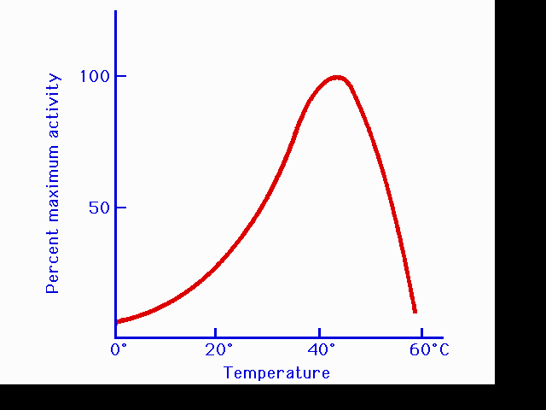
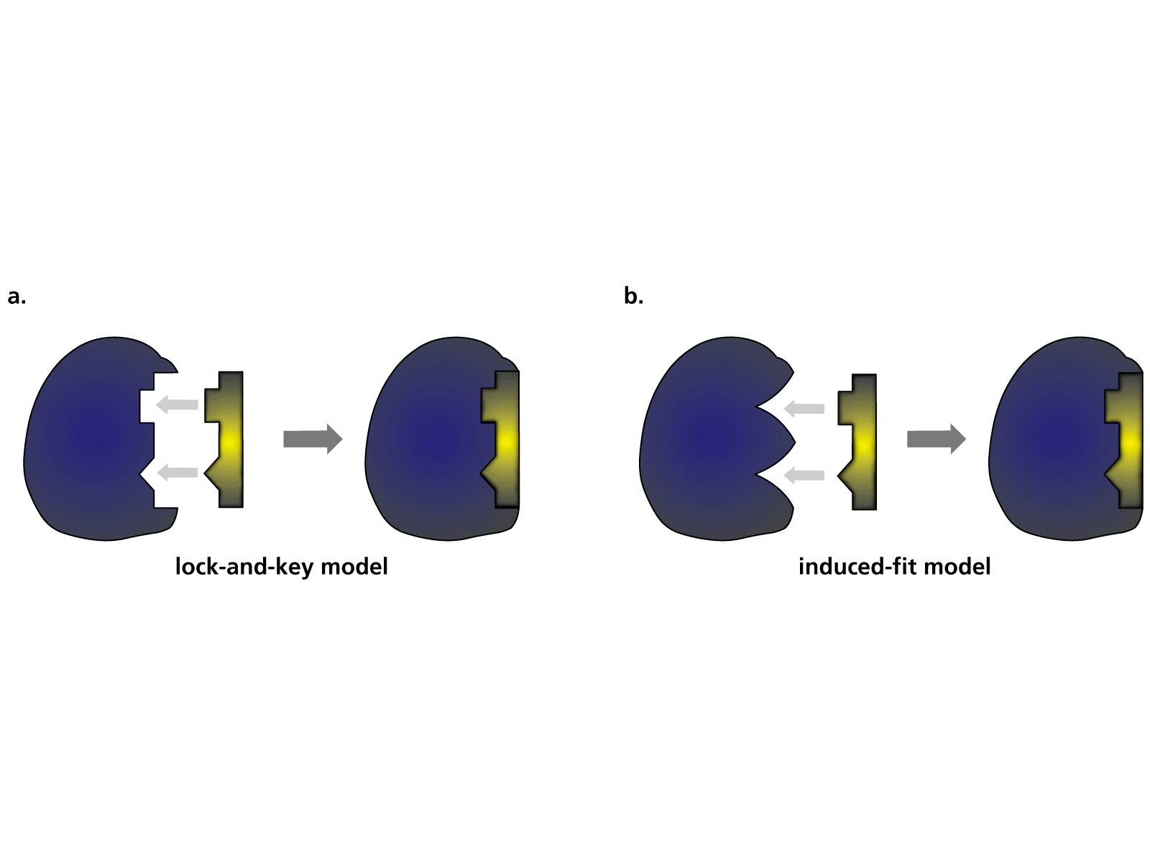
C5 Topic1-What is enzyme
Wendy Chai

Slide 2
Learning objectives
Define catalyst, enzyme.
Explain enzyme action (with reference to the active site, enzyme-substrate complex, substrate and product).
Explain the specificity of enzymes (in terms of the complementary shape and fit of the active site with the substrate).
Investigate and describe the effect of changes in temperature and pH on enzyme activity.
Explain the effect of changes in temperature on enzyme activity (in terms of kinetic energy, shape and fit, frequency of effective collisions and denaturation).
Explain the effect of changes in pH on enzyme activity (in terms of shape and fit and denaturation).

Slide 3
Enzymes
Catalyst- a substance that increases the rate of a chemical reaction and is not changed by the reaction.
Enzymes are biological catalysts – proteins which speed up the rate of chemical reactions in living cells, but are not changed by the reactions.
Task 1. Read p50, construct a 3-column table headed with “enzymes, substrates and products”.

Slide 4
Substrate | Enzyme | Product
Hydrogen peroxide | Catalase | Oxygen and water
Starch | Amylase | Maltose
Maltose | Maltase | Glucose
Sucrose | Sucrase | Glucose + Fructose
Protein | Protease/Pepsin | Amino acids
Carbohydrate | Carbohydrase
Fats | Lipase | Fatty Acids and Glycerol
glucose | starch phosphorylase | starch

Slide 5
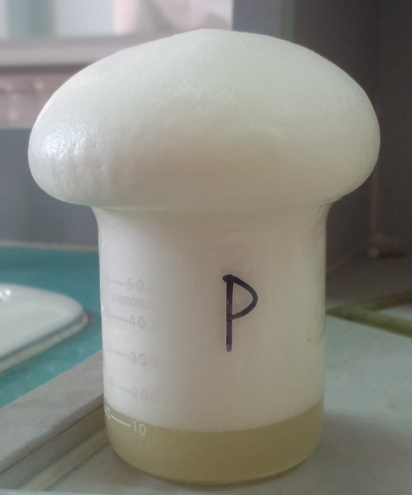
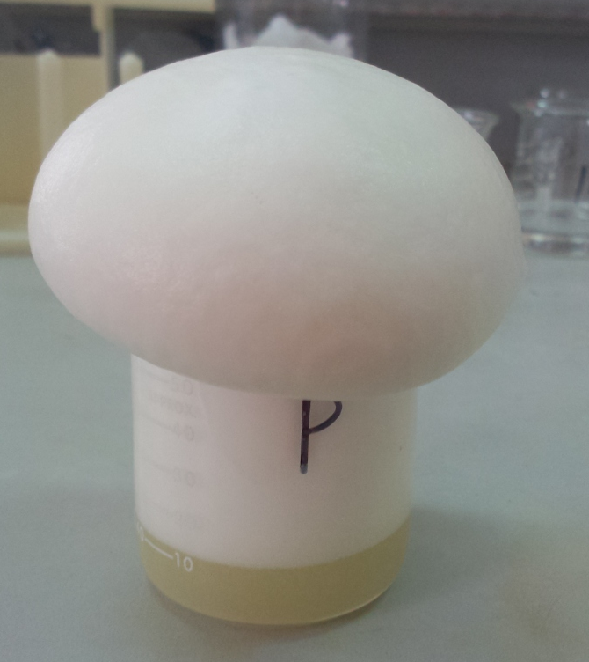
Catalase
catalase
H2O2
H2O + O2
Q: What did I put in the beaker to produce foam like this?
Hint: washing liquid/ detergent can be used to produce foam.

Slide 6
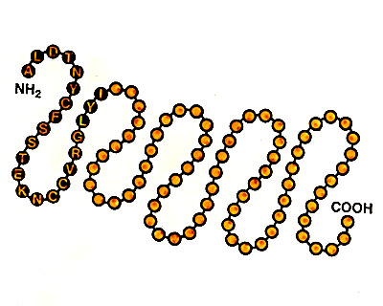
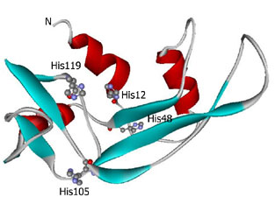
How enzymes work
An enzyme is a protein folded into a complex 3D (three dimensional) shape. The amino acid sequence determines the shape of a protein.
Q: Which organelle joins amino acids together into a protein? Which organelle folds proteins into correct shape?
The enzyme binds to the substrates by its active site.

Slide 7
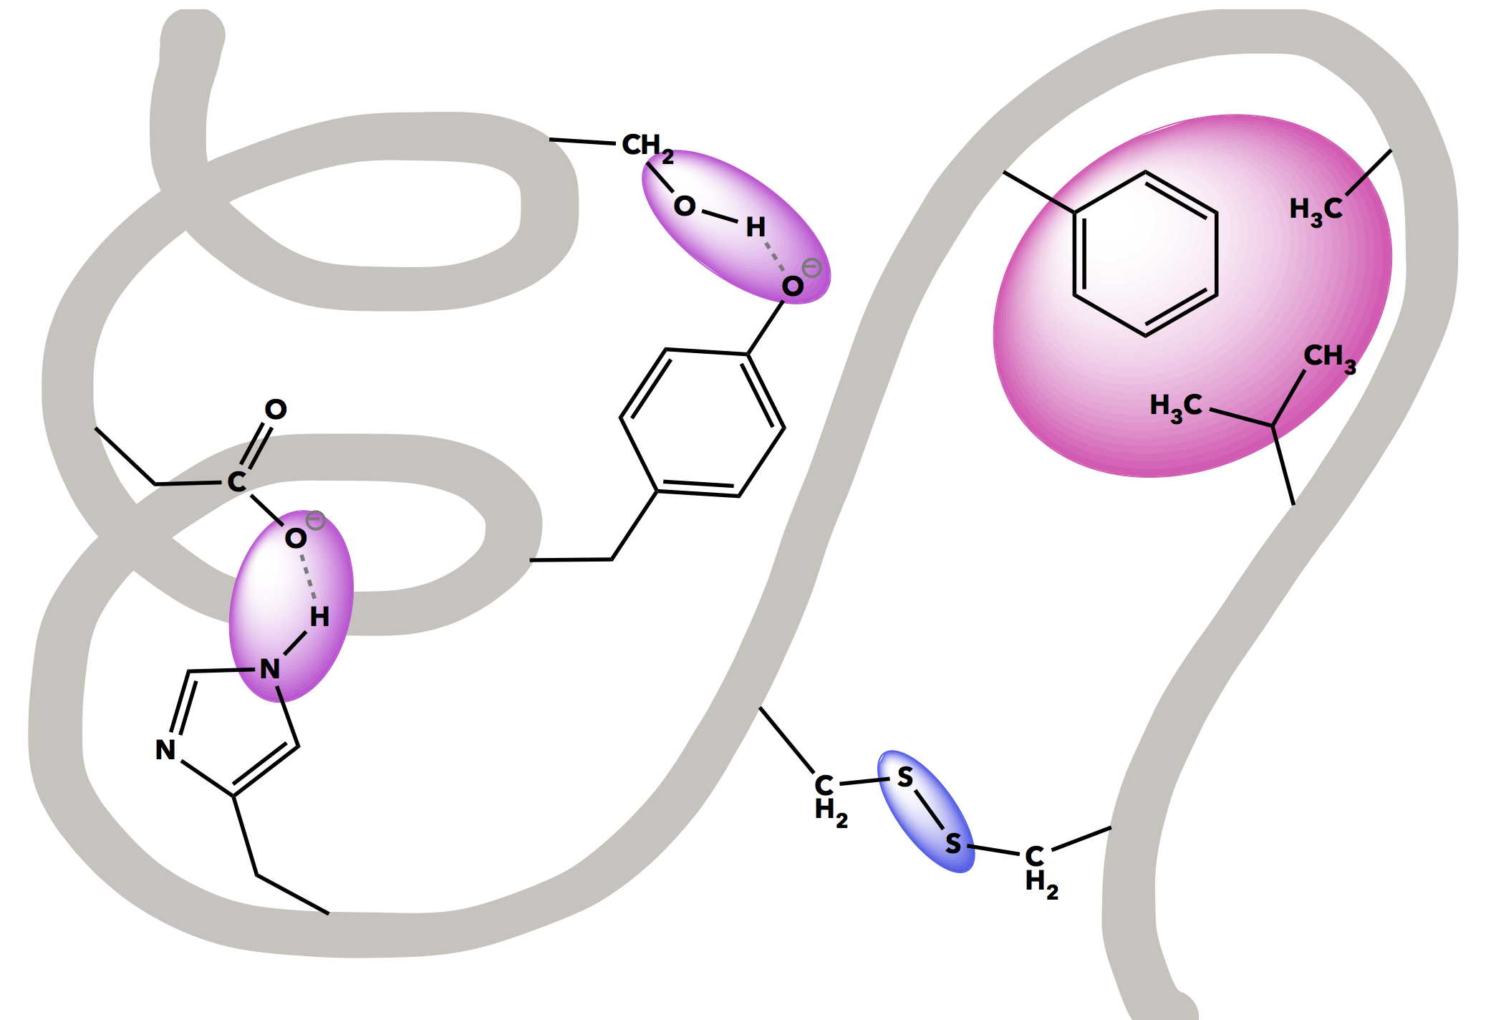

Chemical bonds that hold us together
While biological macromolecules (proteins, lipids, carbohydrates, and DNA) are large and complex, they demonstrate various bonding and intermolecular interactions like the diagram showing.

Slide 8
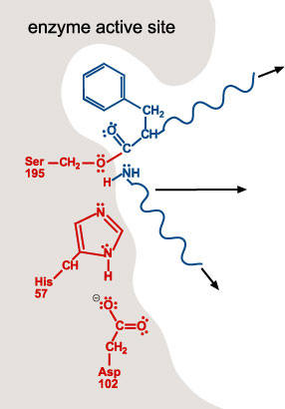
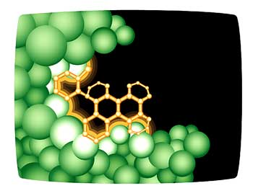
Active site
Is the region of an enzyme where substrate molecules bind and undergo a chemical reaction.

Slide 9
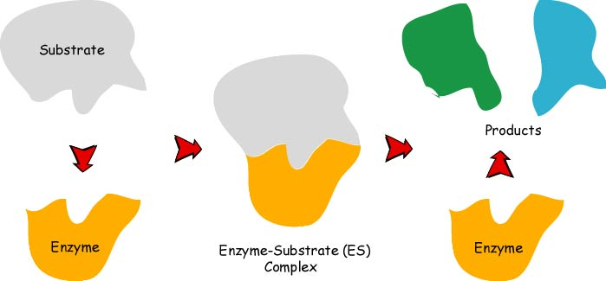
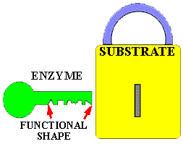
Q: Can you use these terms to describe how enzymes work?
Enzyme-substrate complex
Active site
Substrate, products
Complementary shape
Effective collisions
reuse
Lock and Key
Q: Why do we say “enzymes are specific”? What else we have learned is specific?

Slide 10
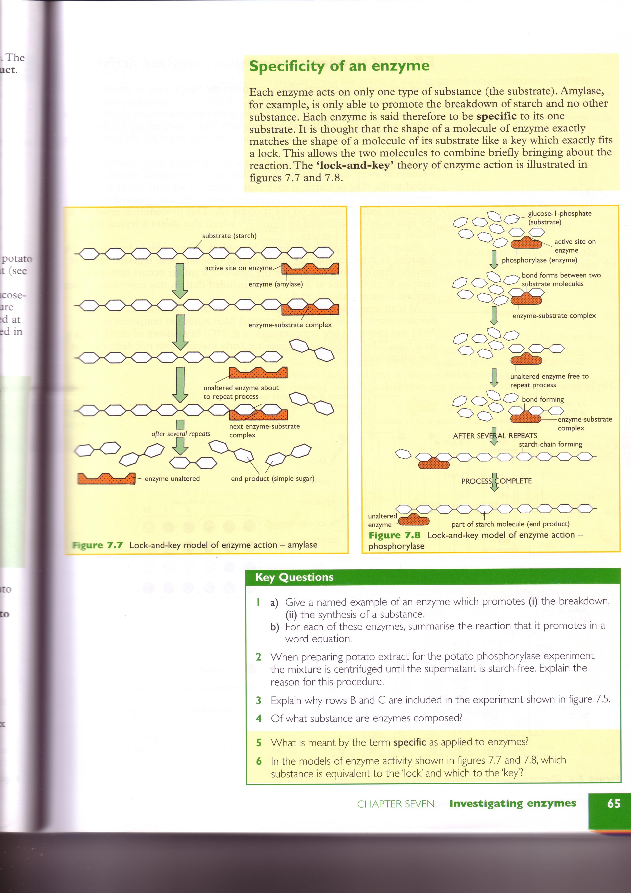
An example (Degradation reactions)
Starch
amylase
Maltose

Slide 11
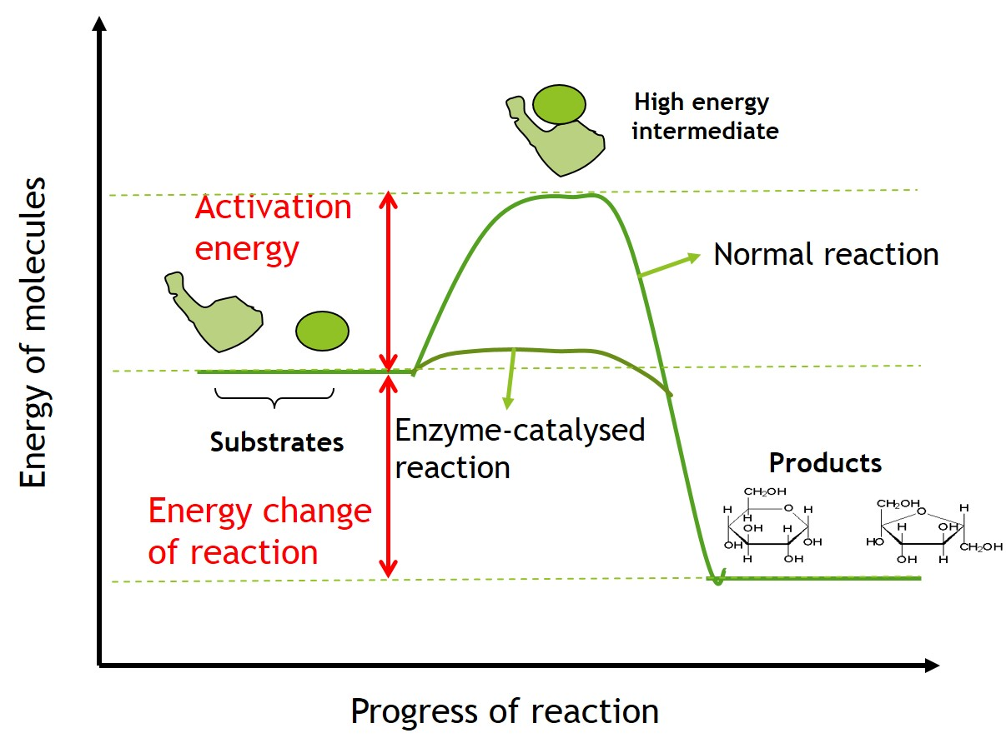
Activation energy
Discussion 1: The oxidation of gasoline is highly exergonic. Despite this, why do cars not spontaneously explode in parking lots?
Enzymes work by lowering the activation energy needed for a chemical reaction to occur, i.e. to make chemical reactions easier to happen.
https://bio.libretexts.org/Courses/University_of_California_Davis/BIS_2A%3A_Introductory_Biology_-_Molecules_to_Cell/MASTER_RESOURCES/Activation_Energy
Notes:
Transition state
Activation energy, in chemistry, the minimum amount of energy that is required to activate atoms or molecules to a condition in which they can undergo chemical transformation.

Slide 12
Activation energy
Discussion 2: If no activation energy were required to break down sucrose (table sugar), would you be able to store it in a sugar bowl?

Slide 13
Enzyme facts
Usually end in ‘…ase’.
Discovered in 1900 in yeasts.
Control almost every metabolic reaction in living organisms. E.g.
CO2(g)+H2O(l)⟶HCO3−(aq)+H⁺(aq) (carbonic anhydrase)
Are globular proteins coiled into a very precise 3-dimentional shape
Possess an active site such as a cleft in the molecule onto which other substrate molecules can bind to form an enzyme-substrate complex
Once the substrate has been either synthesised or split, enzymes can be re-used over and over again.
Require optimum conditions at which they work best.
At high temperature they become denatured.

Slide 14
C5 Topic2- Enzyme activity
Wendy Chai

Slide 15
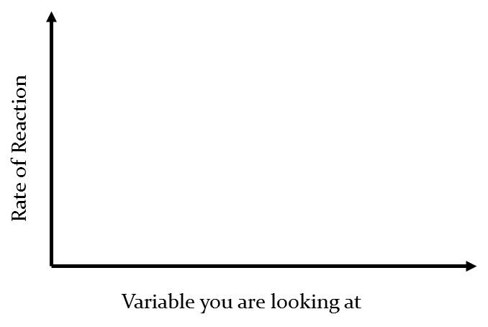
Enzyme activity
Q: How to determine the rate of a chemical reaction? Can you sketch a graph?
Q: What factors affect the activity of an enzyme (how much substrates can be changed to products at any time)?
Temperature
pH
Enzyme Concentration
Substrate Concentration
They work best at a certain temperature and pH.
Rate of Reaction = Amount of substrate consumed
(or amount of products formed)
in a given period of time.

Slide 16
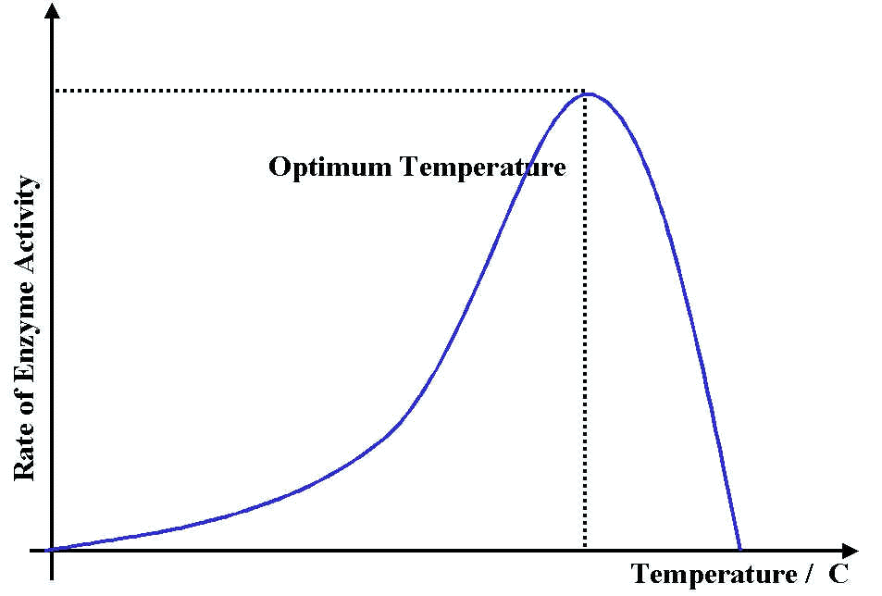
Temperature
Description:
At low temperatures the rate of reaction is slow.
As the temperature increases, the rate of reaction also increases.
At the optimum temperature the rate of reaction reaches a maximum.
Above the optimum temperature the rate of reaction decrease as the temperature increases.
Q: Can you describe and explain how temperature affect enzyme activity?
maximum rate of reaction

Slide 17
Effect of heat on enzyme activity
Q: What happens to enzymes when they are heated/ denatured?
A: Enzymes lose their precise 3D shape, including the active site’s shape, so substrates do not fit, and chemical reactions cannot be catalysed any more.
Q: What happens to enzymes when they are at low temperature? Are enzymes denatured by low temperature?
Q: Can I say “enzyme is killed”?
Denature the protein
When food is cooked, some of its proteins become denatured. This is why boiled eggs become hard and cooked meat becomes firm.
If proteins in a living cell are denatured, this results in disruption of cell activity and possibly cell death.

Slide 18
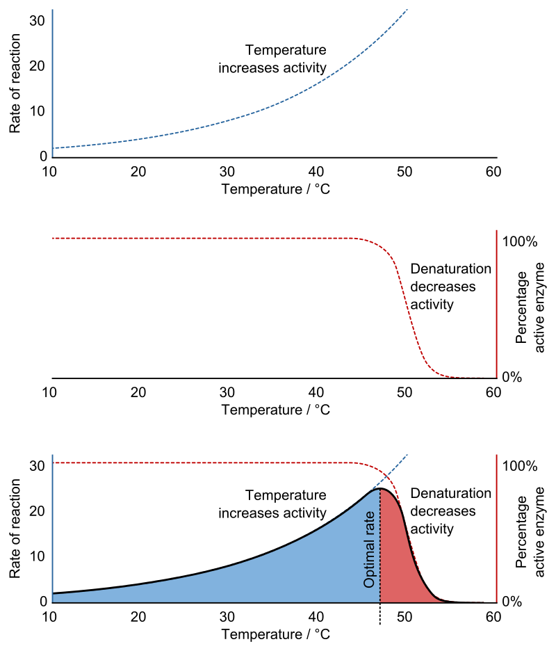
Denaturation & renaturation
Denaturation is a process in which proteins or nucleic acids lose the quaternary structure, tertiary structure, and secondary structure which is present in their native state, by application of some external stress or compound such as a strong acid or base, a concentrated inorganic salt, an organic solvent (e.g., alcohol or chloroform), radiation or heat.
In many cases, denaturation is reversible (the proteins can regain their native state when the denaturing influence is removed). This process can be called renaturation.
Denaturation can also be irreversible.
Notes:
Protein denaturation is also a consequence of cell death. Denatured proteins can exhibit a wide range of characteristics, from conformational change and loss of solubility to aggregation due to the exposure of hydrophobic groups. Denatured proteins lose their 3D structure and therefore cannot function.
In many cases, denaturation is reversible (the proteins can regain their native state when the denaturing influence is removed). This process can be called renaturation.[14] This understanding has led to the notion that all the information needed for proteins to assume their native state was encoded in the primary structure of the protein。
Denaturation of DNA occurs when the weak hydrogen bonds between the double strands are disrupted and the molecule becomes single stranded.

Slide 19
Did you know?
Different enzymes have different optimum temperatures.
Enzymes from human digestive system generally have an optimum of around 37 ℃.
Enzymes from bacteria that live in hot springs may have optimum as high as 75℃.

Slide 20
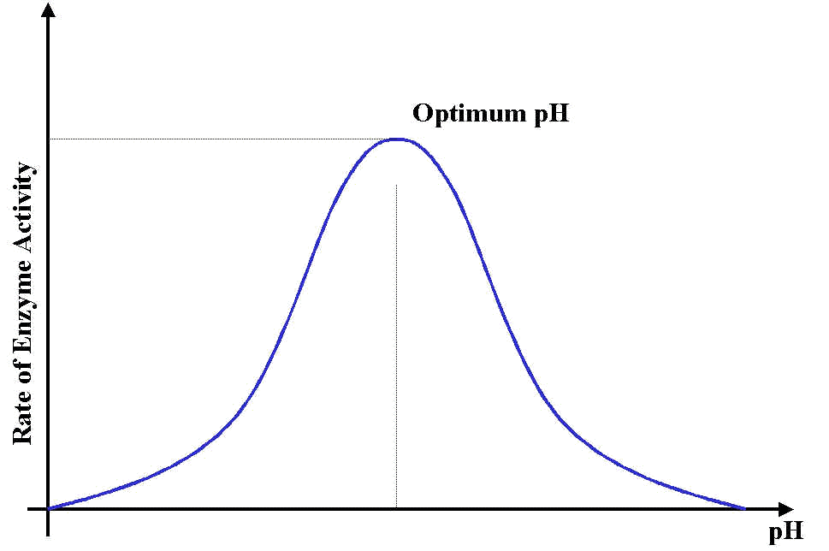
pH and enzyme activity
Q: Can you describe and explain how pH affect enzyme activity?
Hint: You might describe the overall trend, peak value, low value, using decrease/ increase slowly/ rapidly/ steeply, fluctuate, maintain etc.)
Q: Will enzymes be denatured by low and high pH generally? What about pepsin in stomach?
maximum rate of reaction
At low pH, the rate of reaction is slow.
As the pH increases, the rate of reaction increases.
At the optimum pH, the rate of reaction reaches a maximum.
As the pH increases further, the reaction rate decreases.

Slide 21
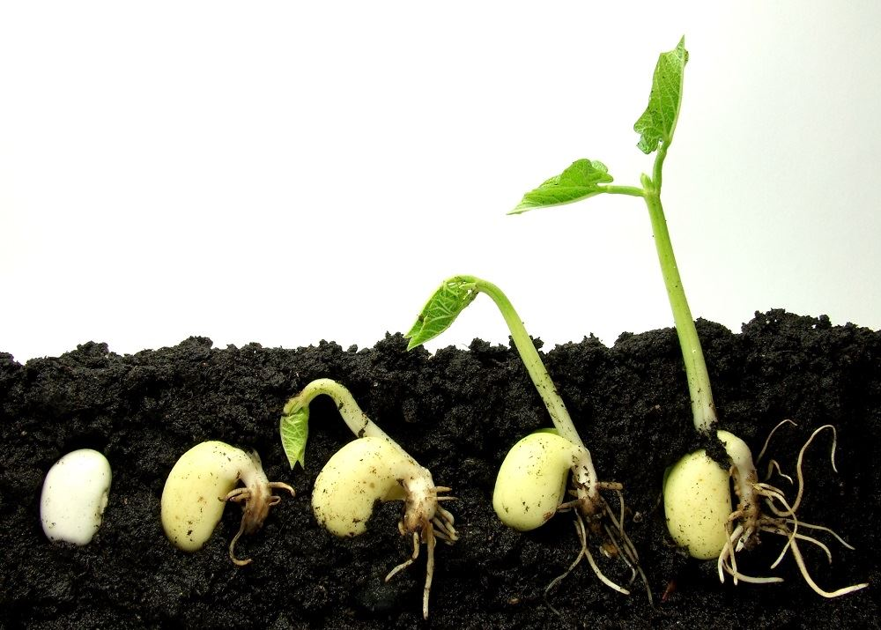
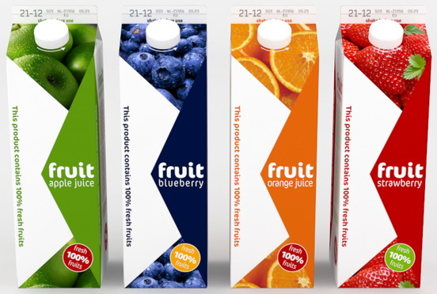
examples of Enzyme usage
Make fruit juice (pectin, pectinase)
Make more fruit juice which is clearer as well.
Seed germination.
Q: What happened when seeds germinate?
Washing powder (e.g. lipase, protease)
Q: Which enzyme component in biological washing powder removes greasy/ oily stains?

Slide 22
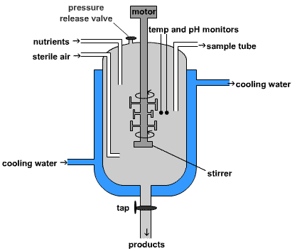
Enzymes from microorganisms
A fermenter is a container used to cultivate/ grow microorganisms which can be used to produce chemicals such as drugs, enzymes or other products.
The enzymes are released into the liquid by the microorganisms.
The liquid is removed from the fermenter and the enzymes are purified before use.

Slide 23
Extra reading resources
1. http://www.abpischools.org.uk/page/modules/enzymes/enzymes1.cfm
2. Interactive model of enzyme action
http://www.kscience.co.uk/animations/model.swf

Slide 24
Activity 5.2
How do they manage to provide different pH condition?
Can you briefly outline what method do they use to measure the activity of catalase? (method, what & when & how to measure)
How do they prepare catalase solution from fresh leaves?
Why leaf discs float after a length time?
What variable has been controlled during the experiment? List at least 4.
Did they repeat the experiment? How many times?
What do you expect to happen if you boil the leaf extract first?
What could possibly be a source of error?

